Slide 1
Analyzing FTICR-MS data
Bob Danczak
robert.danczak@pnnl.gov

Slide 2
What do we plan to cover in this tutorial?
A brief introduction to FTICR-MS as a technique
How is data collected and what happens to it before it reaches you?
FREDA and ftmsRanalysis: Tools which help us analyze FTICR data
Allison Thompson will walk us through the process
Relating FTICR data to other ‘omics
I will guide you along data analysis performed by Emily Graham
Let’s process some data!
I’ve prepared an interactive walkthrough on how to visualize your data and generate conclusions
A brief glimpse into novel analyses that we are developing

Slide 3
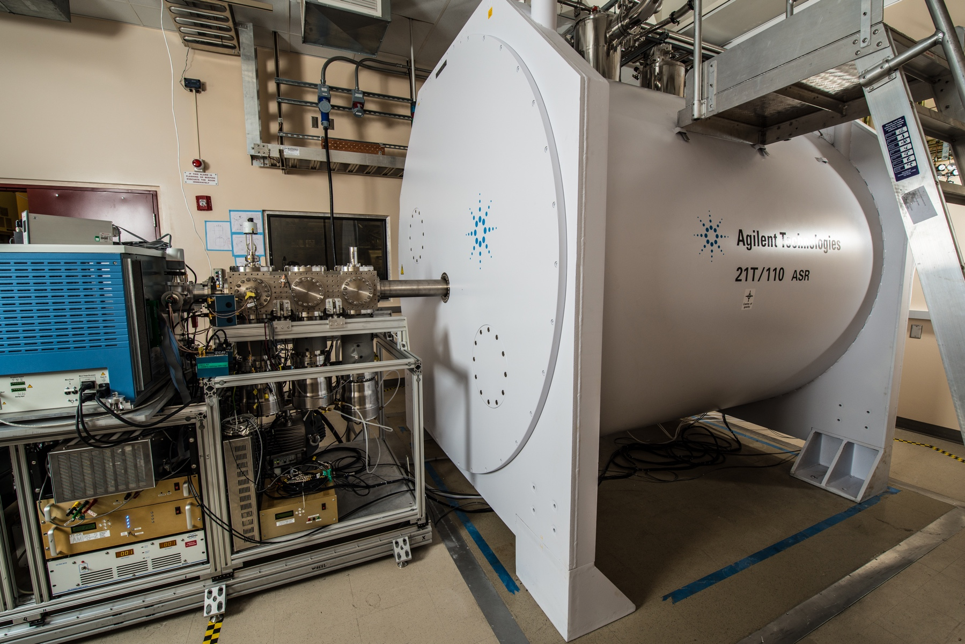
A brief (and basic) introduction to FTICR-MS
FTICR-MS stands for Fourier Transform Ion Cyclotron Resonance Mass Spectrometry
The machine operates by:
Trapping ions in a magnetic field
Exciting ions with a range of pulses so that they orbit within the field, causing oscillations
Measuring the oscillating signal over time
Converting the signal into m/z values using a Fourier transformation
Samples must be ionized first – we typically use ”electron spray ionization in negative mode” or ESI-
There are other ionizations (i.e., MALDI) and modes (i.e., positive) that could yield different results
21T FTICR-MS at EMSL
DISCLAIMER: This is not my area of expertise

Slide 4
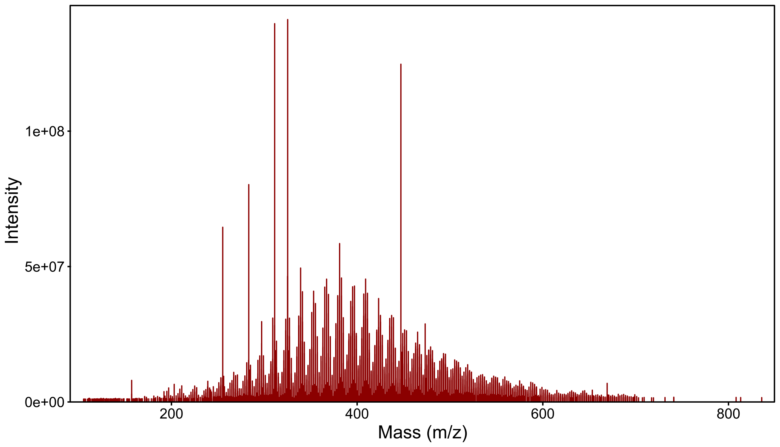
What does the data from the machine look like?
As with other mass spectrometry techniques, we get a spectra of m/z values
Given that the formal charge is usually 1 in our case, these ratios are nearly synonymous with mass
In order to utilize the ultrahigh resolution of this technique, we need to pick our peaks
Various tools exist, but we typically use “Bruker Compass DataAnalysis v4.2”

Slide 5
What does the data from the machine look like?
As with other mass spectrometry techniques, we get a spectra of m/z values
Given that the formal charge is usually 1 in our case, these ratios are nearly synonymous with mass
In order to utilize the ultrahigh resolution of this technique, we need to pick our peaks
Various tools exist, but we typically use “Bruker Compass DataAnalysis v4.2”
Using the automated peak picking tool, we now have mass assignments for potential compounds
325.18484
447.13532
283.26474
255.23340
473.28371
157.12354
669.29840

Slide 6
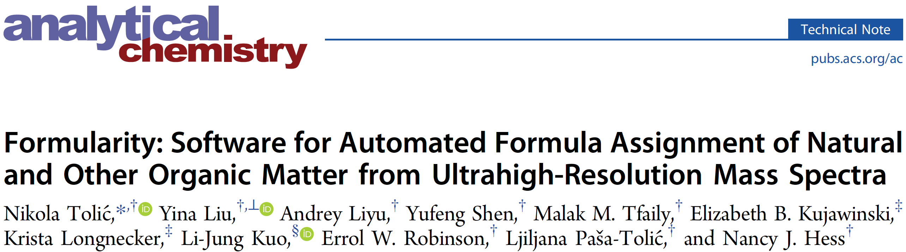
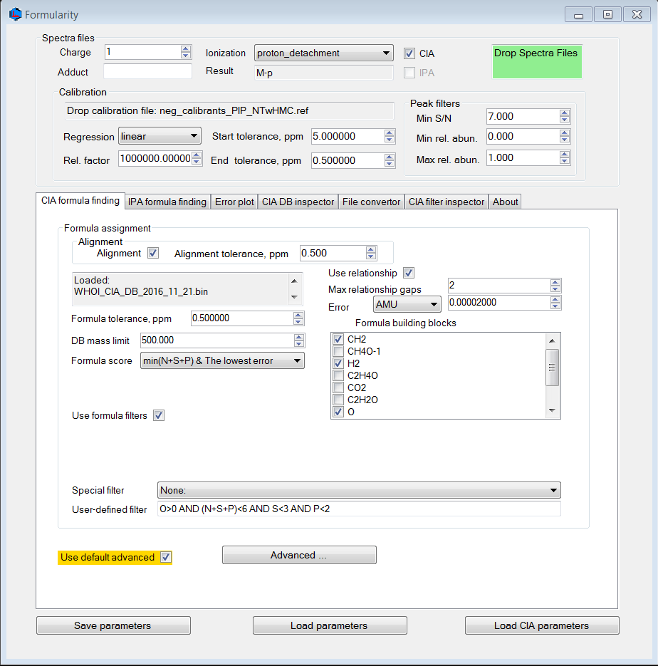
Assigning formulas to identified masses
We use a tool called Formularity to assign formulas to our dataset
Very user-friendly
Developed by Tolic et al. here at EMSL
Alternatives do exist and more are being created
Performs a couple critical processing steps:
Assigns formulas using a database curated by WHOI following a building blocks approach
Calibrates peaks to a set of known, representative masses to ensure consistent masses across datasets
Aligns peaks with slightly different masses to allow for comparisons across samples
DOI: 10.1021/acs.analchem.7b03318

Slide 7
Assigning formulas to identified masses
A quick note about calibration and alignment:
Calibration can be performed by hand in Bruker’s DataAnalysis software
Given minor variations, your results might vary slightly depending on calibration technique
Alignment isn’t necessarily good – slightly adjusting masses to ensure mass compatibility might not be satisfactory
One potential alternative is consider only formulas from each dataset
Many peaks lack formula assignment, however
DOI: 10.1021/acs.analchem.7b03318

Slide 8
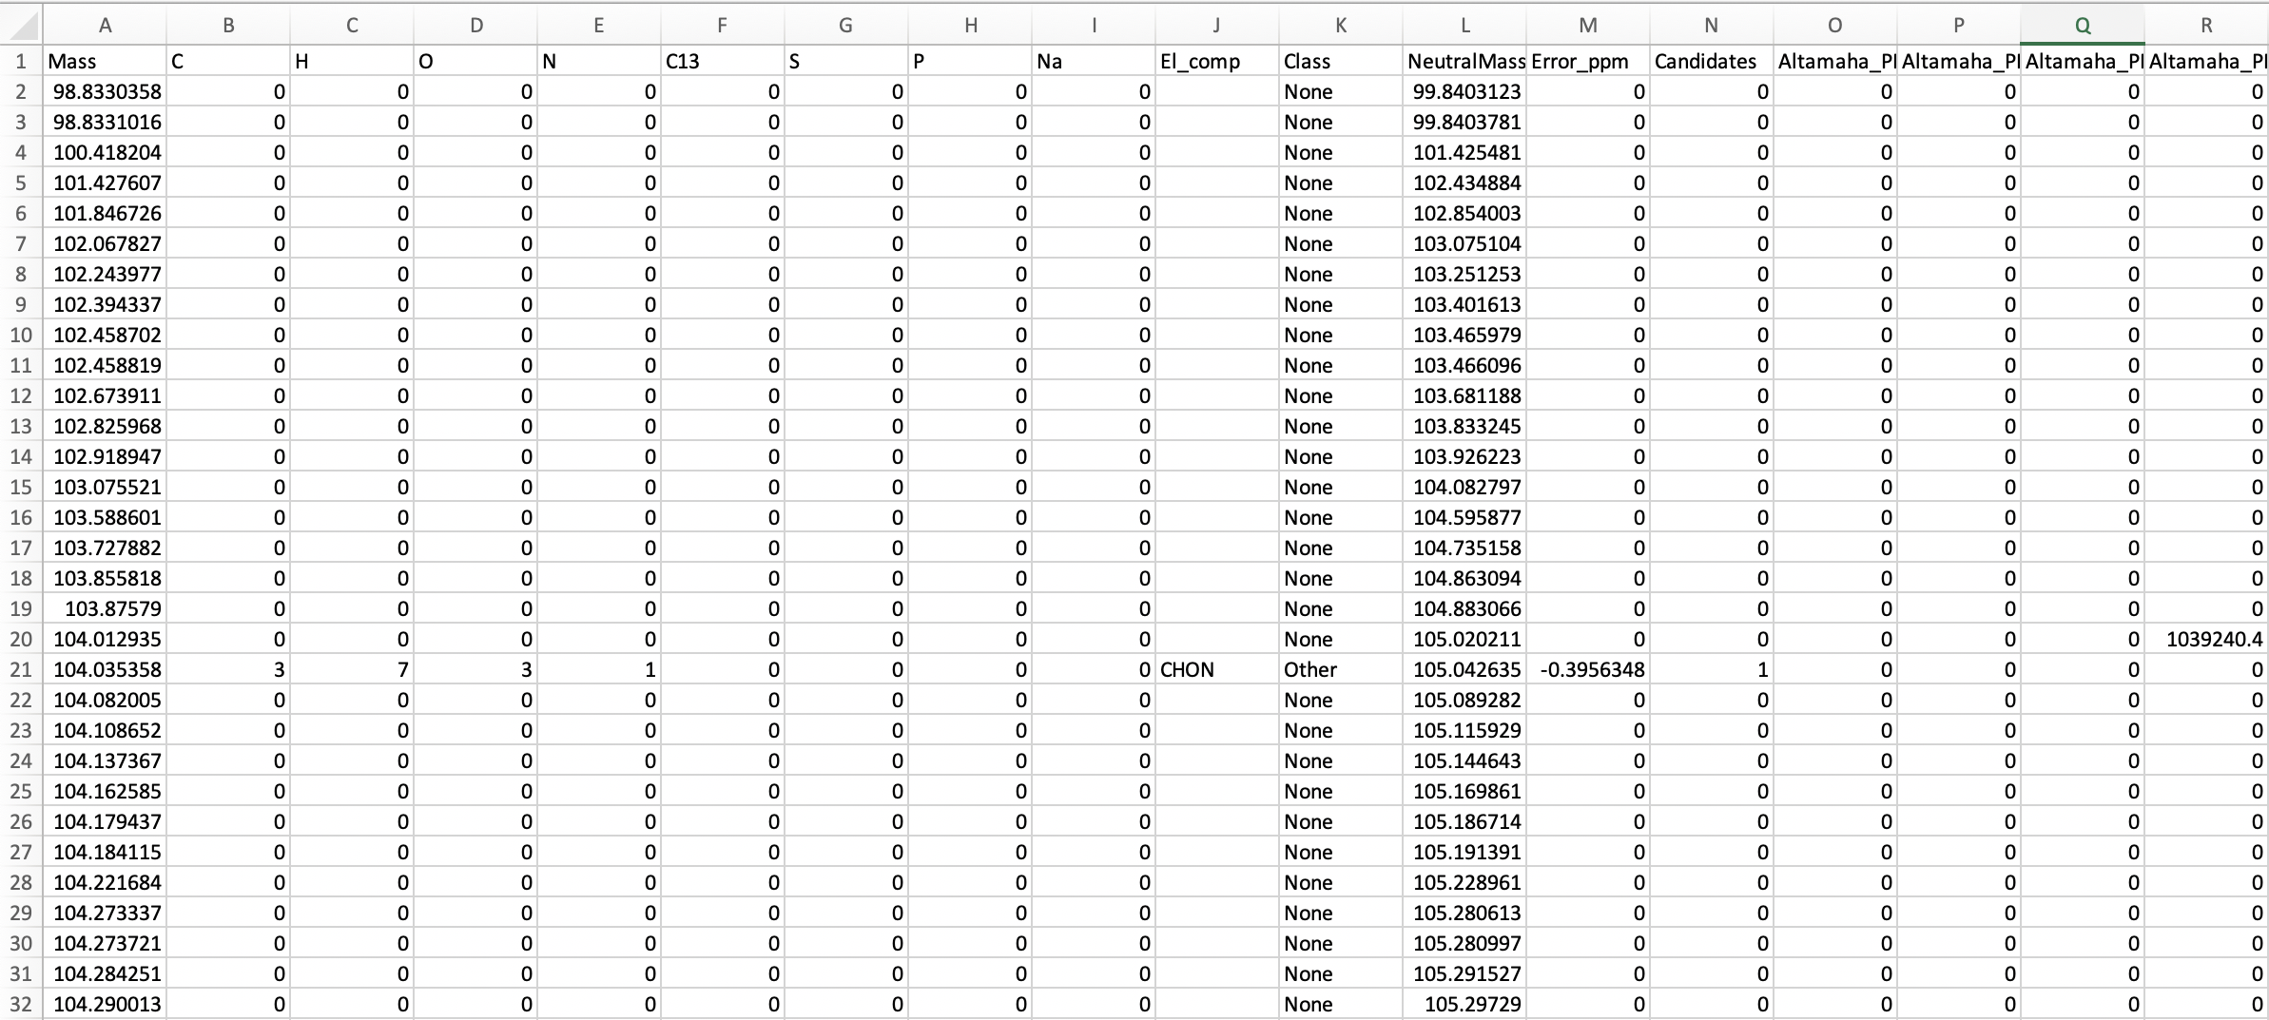
The finalized report
Class
Error
Mass
Stoichiometry
Composition
Neutral
Mass
Formula
Candidates
Samples

Slide 9
What do we plan to cover in this tutorial?
A brief introduction to FTICR-MS as a technique
How is data collected and what happens to it before it reaches you?
FREDA and ftmsRanalysis: Tools which help us analyze FTICR data
Allison Thompson will walk us through the process
Relating FTICR data to other ‘omics
I will guide you along data analysis performed by Emily Graham
Let’s process some data!
I’ve prepared an interactive walkthrough on how to visualize your data and generate conclusions
A brief glimpse into novel analyses that we are developing

Slide 10
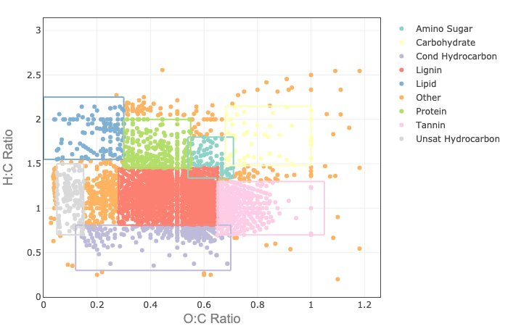
What types of analyses can we do with this data?
Now that you have your report in hand, you can perform many different kinds of analyses
Compare molecular composition across samples
Calculate stoichiometrically derived metrics (i.e., aromaticity index, nominal oxidation state of carbon, etc.)
Perform a Van Krevelen analysis to compare the “carbon landscape” between samples
Rather than develop these capabilities, why not use the ftmsRanalysis R package or it’s web app version FREDA
Double-Bond Equivalent
1 + C – O – S – 0.5(N + P + H)
NOSC
Gibb’s Free Energy
(carbon oxidation)
-(
4C+H-3N-2O+5P-2S
)+4
C
60.3-28.5*NOSC
Example Van Krevelen Graph
Kim et al, 2003; Koch and Dittmar, 2006

Slide 11
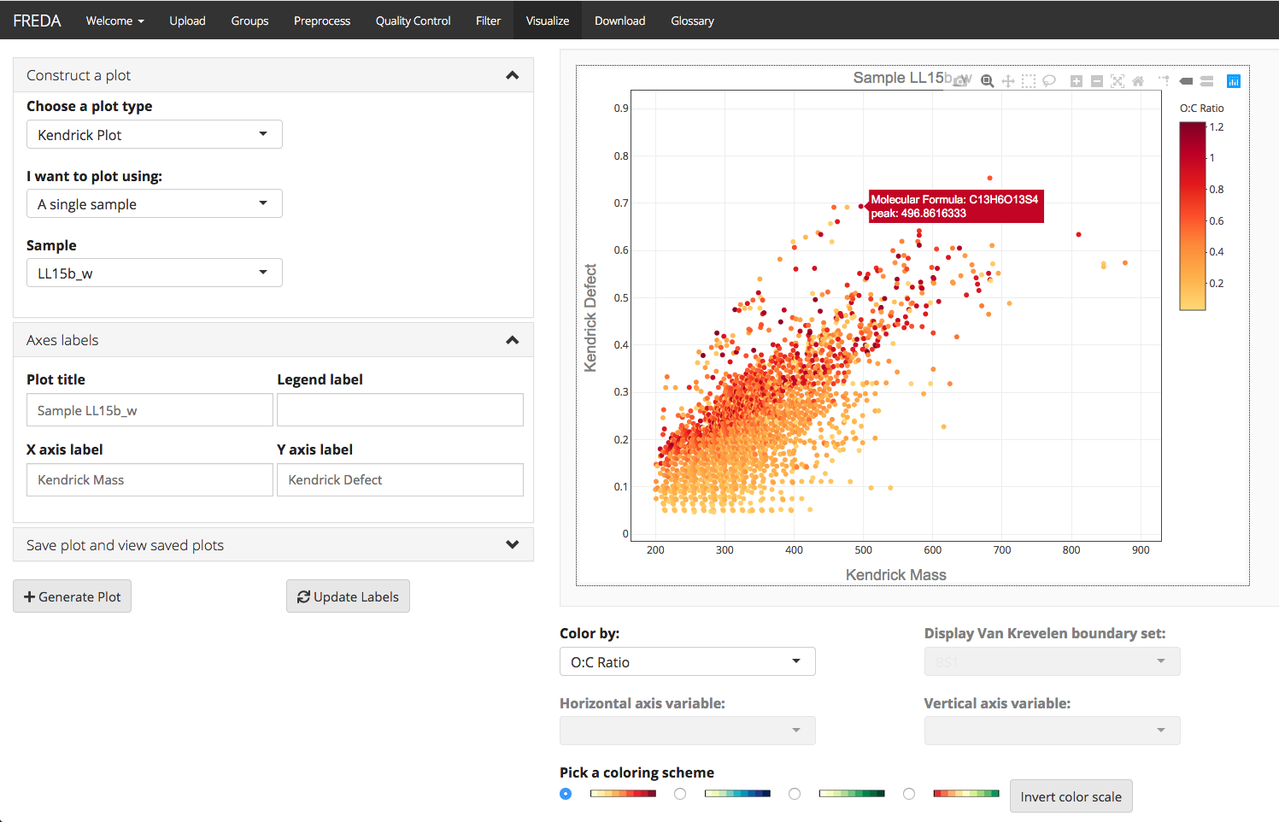
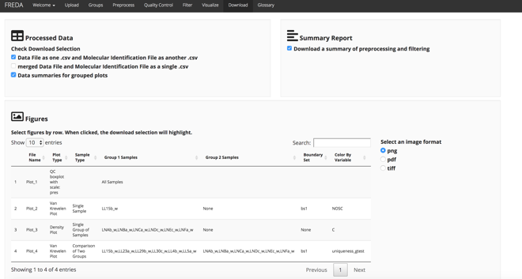
FREDA Walkthrough
Fourier transform R Exploratory Data Analysis (FREDA)
Freely available at:
https://msc-viz.emsl.pnnl.gov/FREDA
Publication in submission to Analytical Chemistry
Contact: Lisa Bramer – lisa.bramer@pnnl.gov

Slide 12
What do we plan to cover in this tutorial?
A brief introduction to FTICR-MS as a technique
How is data collected and what happens to it before it reaches you?
FREDA and ftmsRanalysis: Tools which help us analyze FTICR data
Allison Thompson will walk us through the process
Relating FTICR data to other ‘omics
I will guide you along data analysis performed by Emily Graham
Let’s process some data!
I’ve prepared an interactive walkthrough on how to visualize your data and generate conclusions
A brief glimpse into novel analyses that we are developing

Slide 13
Novel multi ‘omic bioanalytics reveals biogeochemical cycles in high resolution
Metabolomic biochemical transformations
m/z: 400.3356
C₂₀H₁₆O₉
m/z: 499.404
Valine mass: 99.07
Biochemical transformations: Graham et al. (2017) JGR Biogeosciences; Graham et al. (2018) Sci. of Total Environment

Slide 14
Novel multi ‘omic bioanalytics reveals biogeochemical cycles in high resolution
Metabolomic biochemical transformations
Biochemical transformation networks
m/z: 400.3356
C₂₀H₁₆O₉
m/z: 499.404
Valine mass: 99.07
Node = Peak (m/z)
Edge = Transformation
Biochemical transformations: Graham et al. (2017) JGR Biogeosciences; Graham et al. (2018) Sci. of Total Environment

Slide 15
Novel multi ‘omic bioanalytics reveals biogeochemical cycles in high resolution
Metabolomic biochemical transformations
Biochemical transformation networks
Metabolite modules
m/z: 400.3356
C₂₀H₁₆O₉
m/z: 499.404
Valine mass: 99.07
Node = Peak (m/z)
Edge = Transformation
Cluster of biochemically-connected nodes
Biochemical transformations: Graham et al. (2017) JGR Biogeosciences; Graham et al. (2018) Sci. of Total Environment

Slide 16
Novel multi ‘omic bioanalytics reveals biogeochemical cycles in high resolution
Metabolomic biochemical transformations
Biochemical transformation networks
Metabolite modules
Multi ‘omic network
m/z: 400.3356
C₂₀H₁₆O₉
m/z: 499.404
Valine mass: 99.07
Microbial class
Node = Peak (m/z)
Edge = Transformation
Cluster of biochemically-connected nodes
Metabolite modules from different sample types
Enzyme activity
Biochemical transformations: Graham et al. (2017) JGR Biogeosciences; Graham et al. (2018) Sci. of Total Environment

Slide 17

Case Study: Carbon Destabilization at SPRUCE experimental peatland
Peatlands sequester up to 30% of global carbon (C)
Biogeochemical activity in peat is vertically-stratified
Need to understand C cycling mechanisms at intermediate peat depths to predict climate change
Inputs/active cycling
Acrotelm (aerobic)
Redox Fluctuations
Mesotelm
Peat accumulation
Catotelm (anaerobic)
17
How does intermediate peat respond to simulated climate change?
17

Slide 18
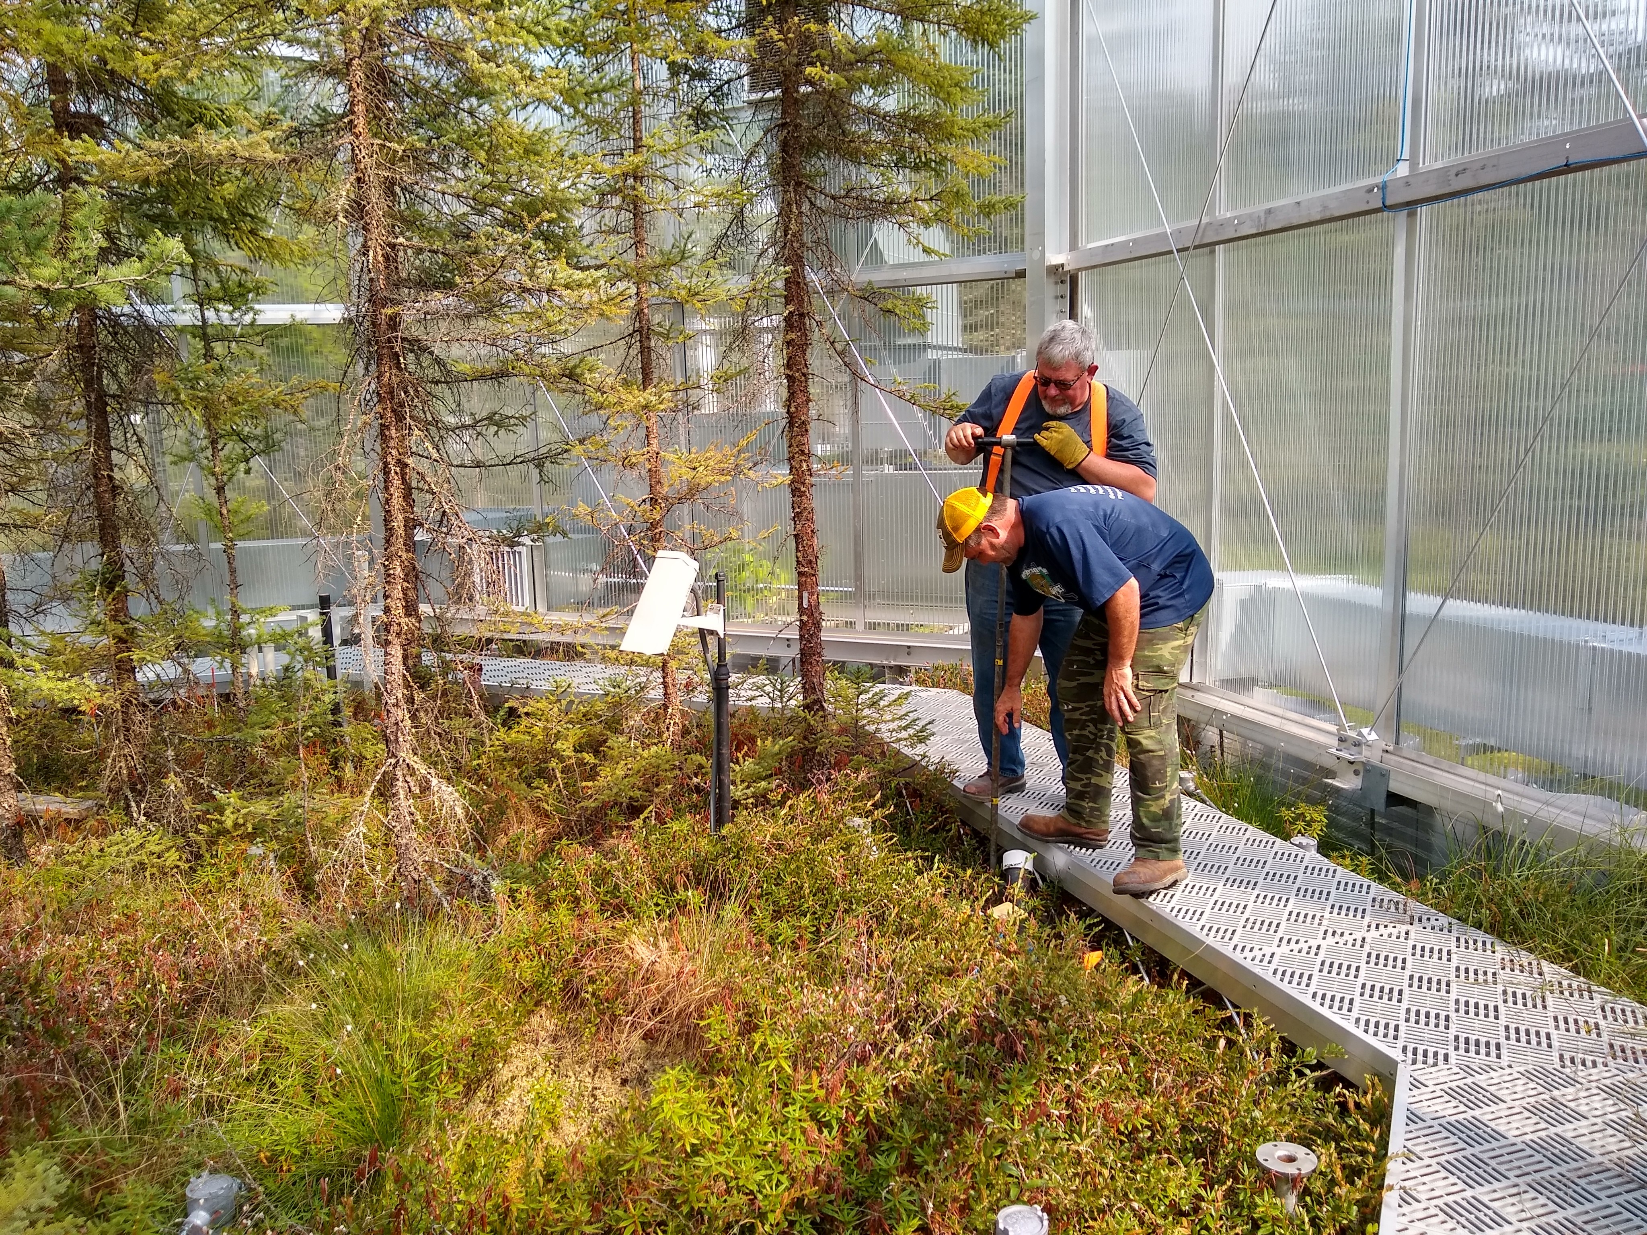
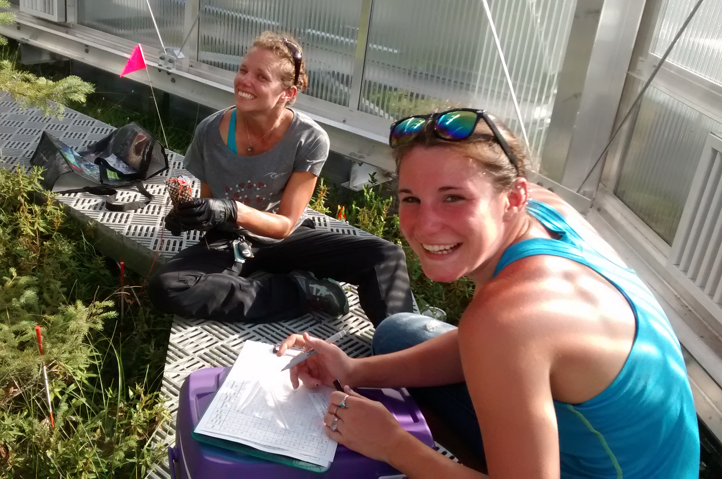
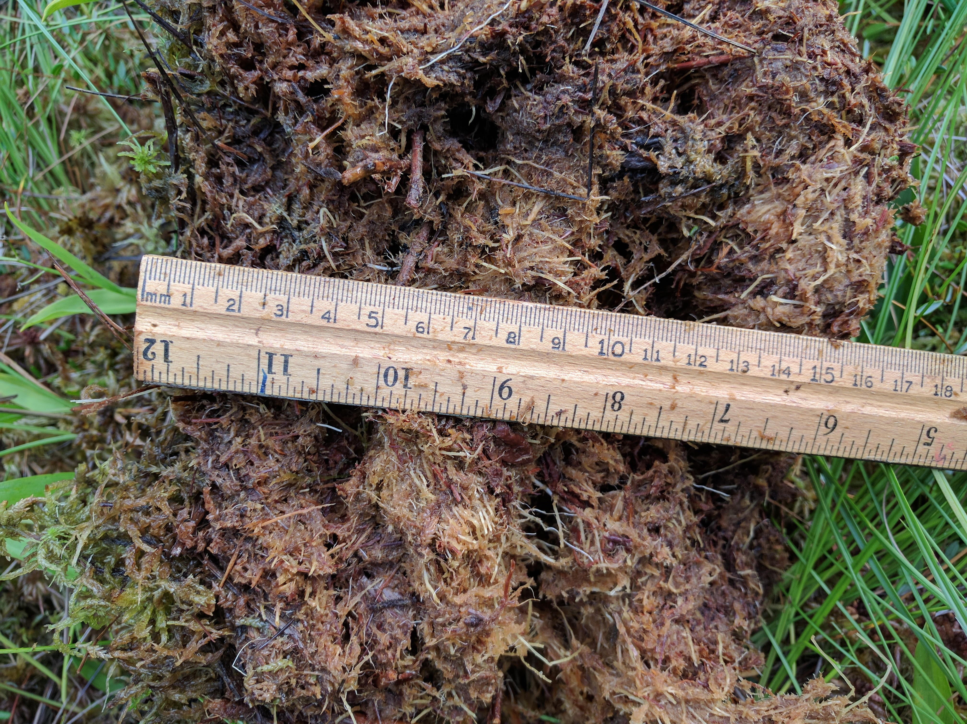
Multi ‘omic analysis from surface and intermediate peat across simulated climate change gradient
0-10 cm and 30-40 cm (6 each), August 2017
Paired ambient and eCO₂ at +0, +2.25, +9T
High resolution metabolomics (NMR, FTICR-MS)
Microbial activity (potential activities of 9 extracellular enzymes for C, N, & P)
Microbial composition (16S rRNA gene sequencing)
Standard physicochemistry (T, moisture, DOC, etc.)

Slide 19
Tradeoffs between organic C, N, and P cycling
As C cycling becomes more energetically costly, organic N cycling increases
With increases in organic N cycling, microbial investment in C and organic P declines
Less bioavailable
C bioavailability
C-acquiring enzyme
P-acquiring enzyme
More bioavailable
Less Organic N Cycling
More Organic N Cycling
Notes:
Fig 2. Tradeoffs between organic C, N, and P cycling in SPRUCE acrotelm. (A) As C cycling becomes more energetically costly, organic N cycling increases. With increases in organic N cycling, microbial investment in (B) C and (C) organic P declines. dGCox is the mean GFE of all peaks in a given sample; amino acid transformations denote the number of times a biochemical transformation assigned to an amino acid was present in the sample; and enzyme activities in (B) and (C) are potential activities derived from extracellular enzyme assays.

Slide 20
Multi ‘omic network reveals response of microbes and biochemistry to climate change
Node Key
Brown = Microbial Class Teal = Extracellular Enzyme
Light Green = Ambient Surface Metabolite Module Dark Green = Climate Surface Metabolite Module
Light Pink = Ambient Intermediate Metabolite Module Dark Pink = Climate Intermediate Metabolite Module
Intermediate
Climate
Change
Climate Change
Surface
Notes:
Fig 6. Distinct C chemistry and biochemical responses to temperature and CO2 across surface-to-intermediate depth. (A) In surface peat, biochemical C modules from ambient plots were associated with EEA and microoranisms typically assocaited with aerobic respiration (acidos, chitinophagia, flavo, gemma). Under elevated CO2/T, microbiomes associated with biochemical C modules shifted towards methane oxidizing and photosynthetic tax (methyl… Melainabacteria) as well as betaPB, other PB, and chlamydia (tighter network, few microbes). (B-E) show the normalized different of chemical attributes of organic matter (B-D) or biocehmical transformations (E) under ambient vs. simulated climate change within each layer.

Slide 21
Multi ‘omic network reveals response of microbes and biochemistry to climate change
Node Key
Brown = Microbial Class Teal = Extracellular Enzyme
Light Green = Ambient Surface Metabolite Module Dark Green = Climate Surface Metabolite Module
Light Pink = Ambient Intermediate Metabolite Module Dark Pink = Climate Intermediate Metabolite Module
Intermediate
Surface: Climate change suppresses diversity of organisms associated with metabolite modules
Climate
Change
Climate Change
Surface
Notes:
Fig 6. Distinct C chemistry and biochemical responses to temperature and CO2 across surface-to-intermediate depth. (A) In surface peat, biochemical C modules from ambient plots were associated with EEA and microoranisms typically assocaited with aerobic respiration (acidos, chitinophagia, flavo, gemma). Under elevated CO2/T, microbiomes associated with biochemical C modules shifted towards methane oxidizing and photosynthetic tax (methyl… Melainabacteria) as well as betaPB, other PB, and chlamydia (tighter network, few microbes). (B-E) show the normalized different of chemical attributes of organic matter (B-D) or biocehmical transformations (E) under ambient vs. simulated climate change within each layer.

Slide 22
Multi ‘omic network reveals response of microbes and biochemistry to climate change
Node Key
Brown = Microbial Class Teal = Extracellular Enzyme
Light Green = Ambient Surface Metabolite Module Dark Green = Climate Surface Metabolite Module
Light Pink = Ambient Intermediate Metabolite Module Dark Pink = Climate Intermediate Metabolite Module
Intermediate
Surface: Climate change suppresses diversity of organisms associated with metabolite modules
Climate
Change
Climate Change
Surface
Notes:
Fig 6. Distinct C chemistry and biochemical responses to temperature and CO2 across surface-to-intermediate depth. (A) In surface peat, biochemical C modules from ambient plots were associated with EEA and microoranisms typically assocaited with aerobic respiration (acidos, chitinophagia, flavo, gemma). Under elevated CO2/T, microbiomes associated with biochemical C modules shifted towards methane oxidizing and photosynthetic tax (methyl… Melainabacteria) as well as betaPB, other PB, and chlamydia (tighter network, few microbes). (B-E) show the normalized different of chemical attributes of organic matter (B-D) or biocehmical transformations (E) under ambient vs. simulated climate change within each layer.

Slide 23
Multi ‘omic network reveals response of microbes and biochemistry to climate change
Node Key
Brown = Microbial Class Teal = Extracellular Enzyme
Light Green = Ambient Surface Metabolite Module Dark Green = Climate Surface Metabolite Module
Light Pink = Ambient Intermediate Metabolite Module Dark Pink = Climate Intermediate Metabolite Module
Intermediate
Intermediatiate: Climate change favors one specific class of organisms: Solibacteres (Acidobacteria group3)
Climate
Change
Climate Change
Surface
Notes:
Fig 6. Distinct C chemistry and biochemical responses to temperature and CO2 across surface-to-intermediate depth. (A) In surface peat, biochemical C modules from ambient plots were associated with EEA and microoranisms typically assocaited with aerobic respiration (acidos, chitinophagia, flavo, gemma). Under elevated CO2/T, microbiomes associated with biochemical C modules shifted towards methane oxidizing and photosynthetic tax (methyl… Melainabacteria) as well as betaPB, other PB, and chlamydia (tighter network, few microbes). (B-E) show the normalized different of chemical attributes of organic matter (B-D) or biocehmical transformations (E) under ambient vs. simulated climate change within each layer.

Slide 24
Multi ‘omic network reveals response of microbes and biochemistry to climate change
Node Key
Brown = Microbial Class Teal = Extracellular Enzyme
Light Green = Ambient Surface Metabolite Module Dark Green = Climate Surface Metabolite Module
Light Pink = Ambient Intermediate Metabolite Module Dark Pink = Climate Intermediate Metabolite Module
Intermediate
Intermediatiate: Climate change favors one specific class of organisms: Solibacteres (Acidobacteria group3)
Climate
Change
Climate Change
Surface
Notes:
Fig 6. Distinct C chemistry and biochemical responses to temperature and CO2 across surface-to-intermediate depth. (A) In surface peat, biochemical C modules from ambient plots were associated with EEA and microoranisms typically assocaited with aerobic respiration (acidos, chitinophagia, flavo, gemma). Under elevated CO2/T, microbiomes associated with biochemical C modules shifted towards methane oxidizing and photosynthetic tax (methyl… Melainabacteria) as well as betaPB, other PB, and chlamydia (tighter network, few microbes). (B-E) show the normalized different of chemical attributes of organic matter (B-D) or biocehmical transformations (E) under ambient vs. simulated climate change within each layer.

Slide 25
Metabolomes reveal climate-driven S and plant input cycling in surface; organic N in intermediate
C type
Elemental composition
Functional Group
0.1
-0.1
-0.3
Surface Differences
Intermediate Differences

Slide 26
What do we plan to cover in this tutorial?
A brief introduction to FTICR-MS as a technique
How is data collected and what happens to it before it reaches you?
FREDA and ftmsRanalysis: Tools which help us analyze FTICR data
Allison Thompson will walk us through the process
Relating FTICR data to other ‘omics
I will guide you along data analysis performed by Emily Graham
Let’s process some data!
I’ve prepared an interactive walkthrough on how to visualize your data and generate conclusions
A brief glimpse into novel analyses that we are developing

Slide 27
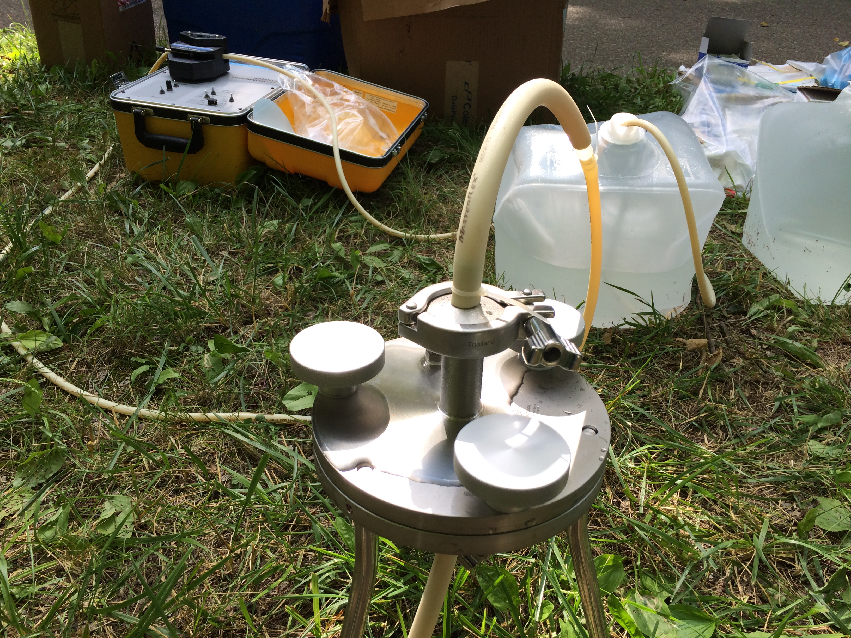


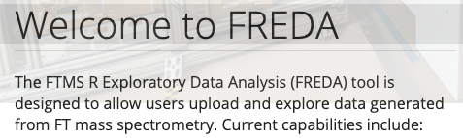
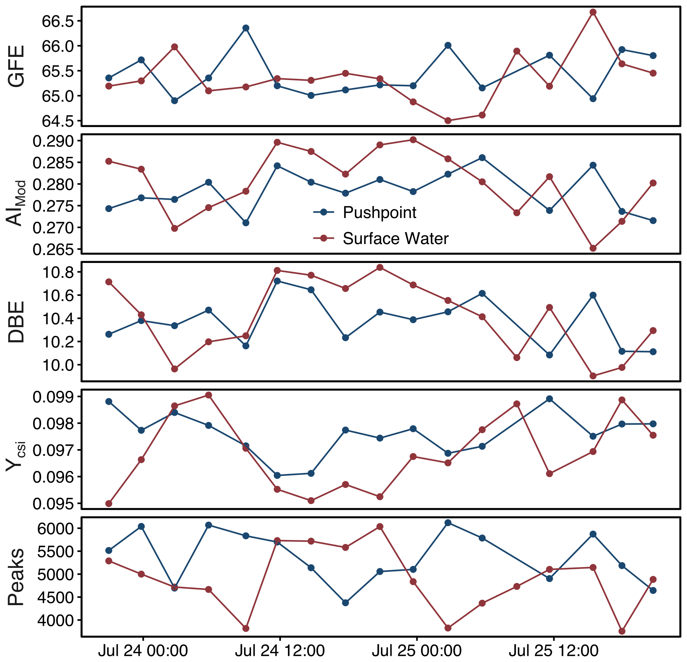
Let’s analyze some data together!
Now we are going to walkthrough a data analysis challenge together:
All the files you need can be found on GitHub - https://github.com/danczakre/ICRTutorial
There are a couple preliminary steps before we can start which are outlined in the walkthrough document on GitHub
Goal for today: Perform pre-processing on a report generated by Formularity, then produce and interpret some figures
Sample Collection
Run samples on ICR
Data analysis
Data preprocessing
Data interpretation

Slide 28
Let’s analyze some data together!
Now we are going to walkthrough a data analysis challenge together:
All the files you need can be found on GitHub - https://github.com/danczakre/ICRTutorial
There are a couple preliminary steps before we can start which are outlined in the walkthrough document on GitHub
Goal for today: Perform pre-processing on a report generated by Formularity, then produce and interpret some figures
Sample Collection
Run samples on ICR
Data analysis
Data preprocessing
Data interpretation

Slide 29
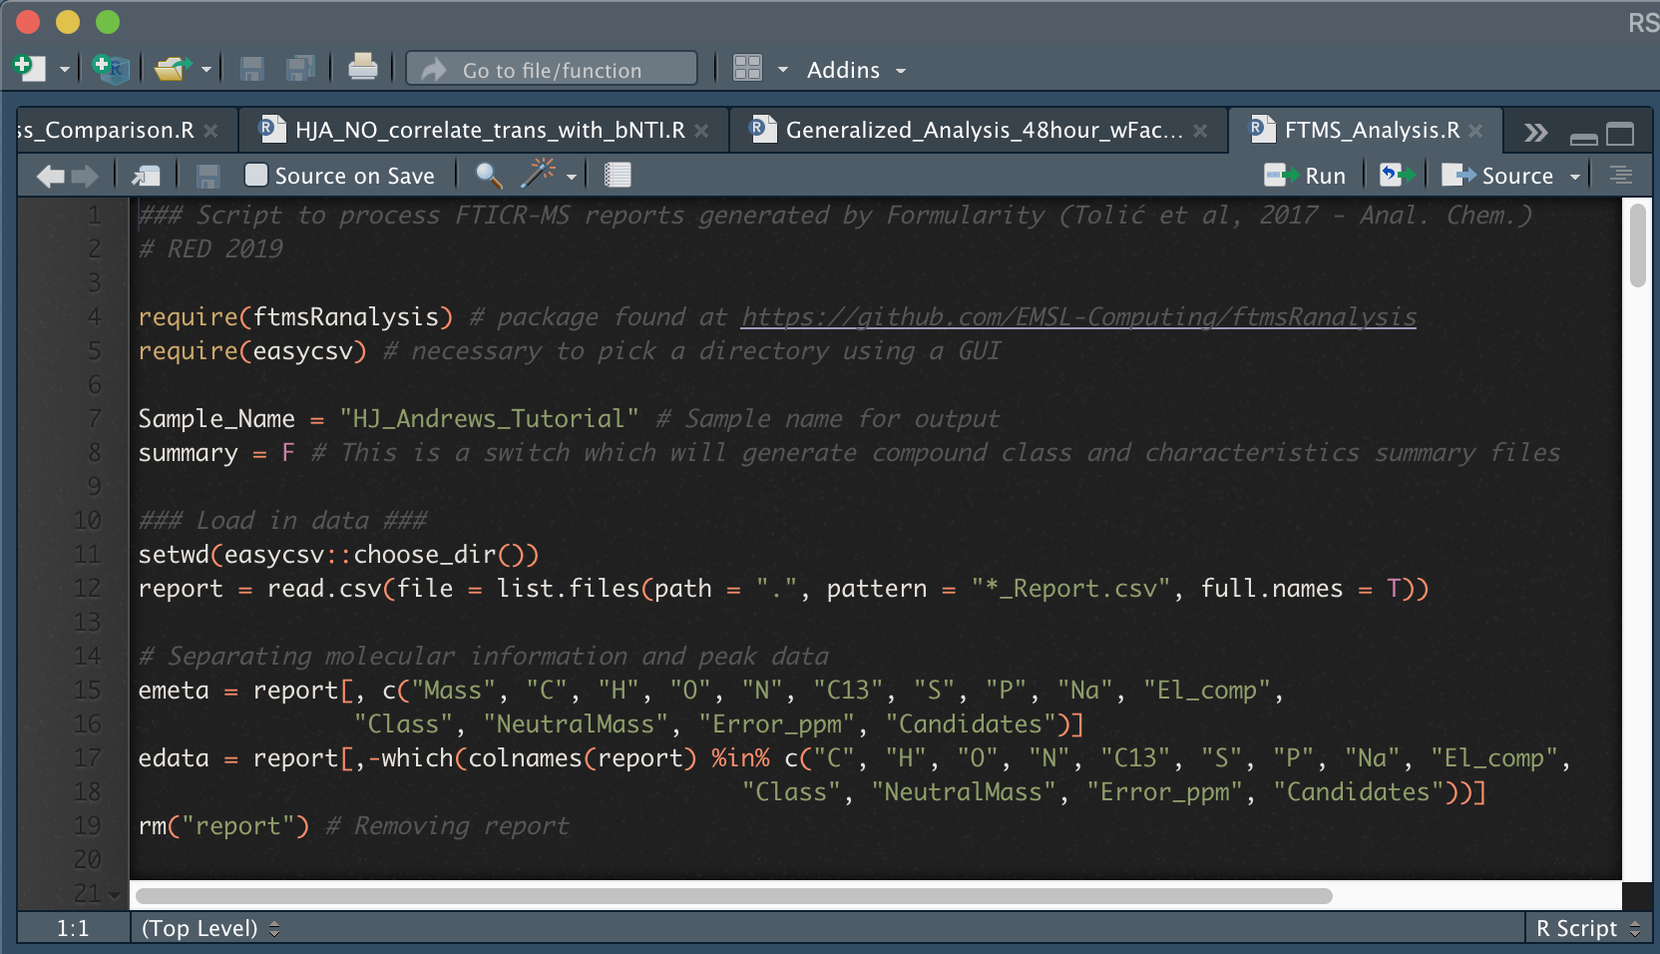
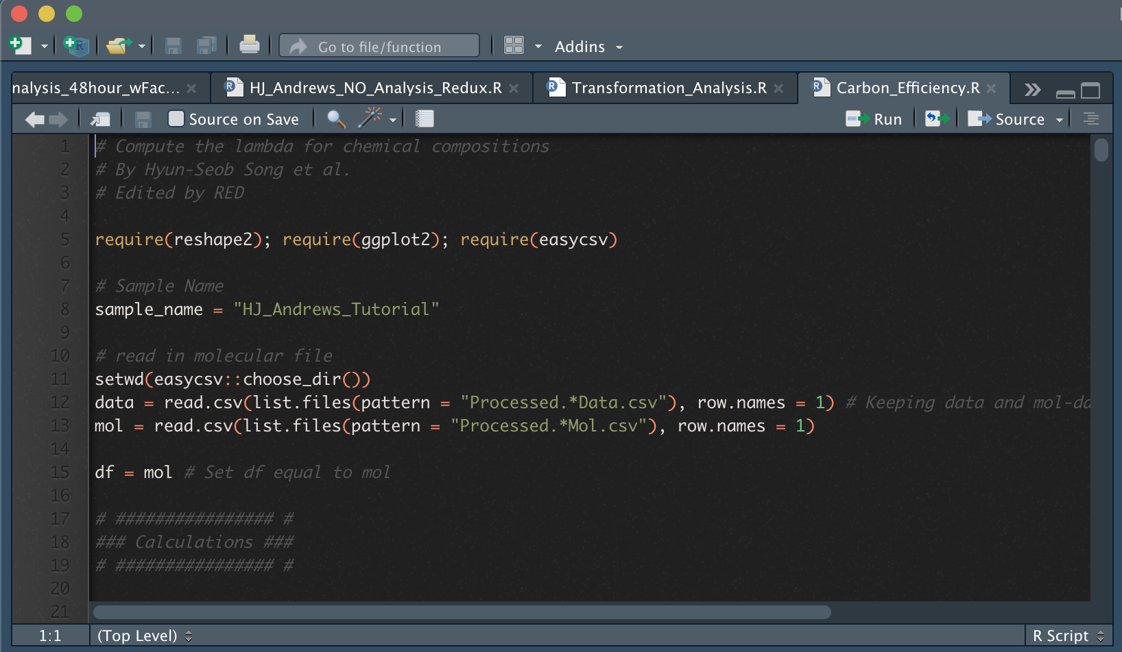
Data Preprocessing
This is a quick view of the FTMS_Analysis.R which utilizes the ftmsRanalysis package
Pressing the “Source” button will run the entire script
You should see a pop-up asking you to select the directory containing the Report
This script will generate two files, a Data and Mol file.
Removes peaks with an isotopic signature, and filters based upon a mass range of 200-900 m/z

Slide 30

Overview of data analytics
Two files should have been generated:
The Data file contains the compound-by-site information
The Mol file contains molecular information (i.e., stoichiometry, NOSC)
These two files can now be used in many different analyses
What types of carbon are present and do they change through space/time?
Are the profiles similar or distinct to each other?
When and where is carbon more thermodynamically available?
We will walk through two specific analyses, transformations and carbon use
Data
Thermodynamics
Mol
Transformation Analysis
Multivariate Analyses

Slide 31
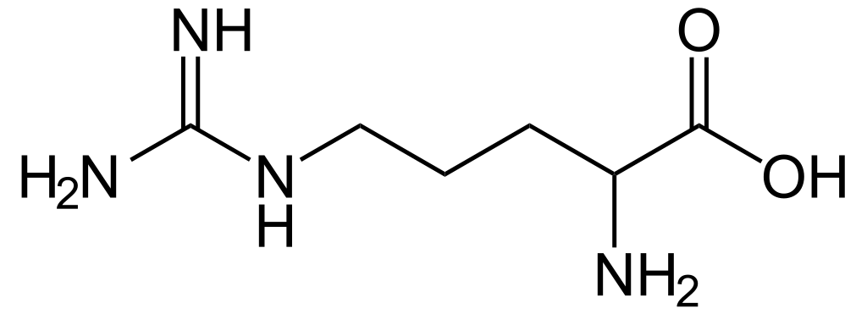
The transformation analysis
Example of a transformation
The ultrahigh-resolution mass accuracy of FTICR data enables us to perform a “transformation analysis”
By calculating the mass difference between compounds, we can assign biochemical transformations according to a database of known transformations with exact masses
More importantly, these transformations can be used to construct a transformation network
We will not be covering this in detail, but differences in networks might be indicate differing biochemical capabilities
Difference of ~156.1011167 m/z
Compound 1
(541.1563282 m/z)
Compound 2
(385.0552115 m/z)
~156.1011167 m/z
=
Arginine
Transformation Network

Slide 32
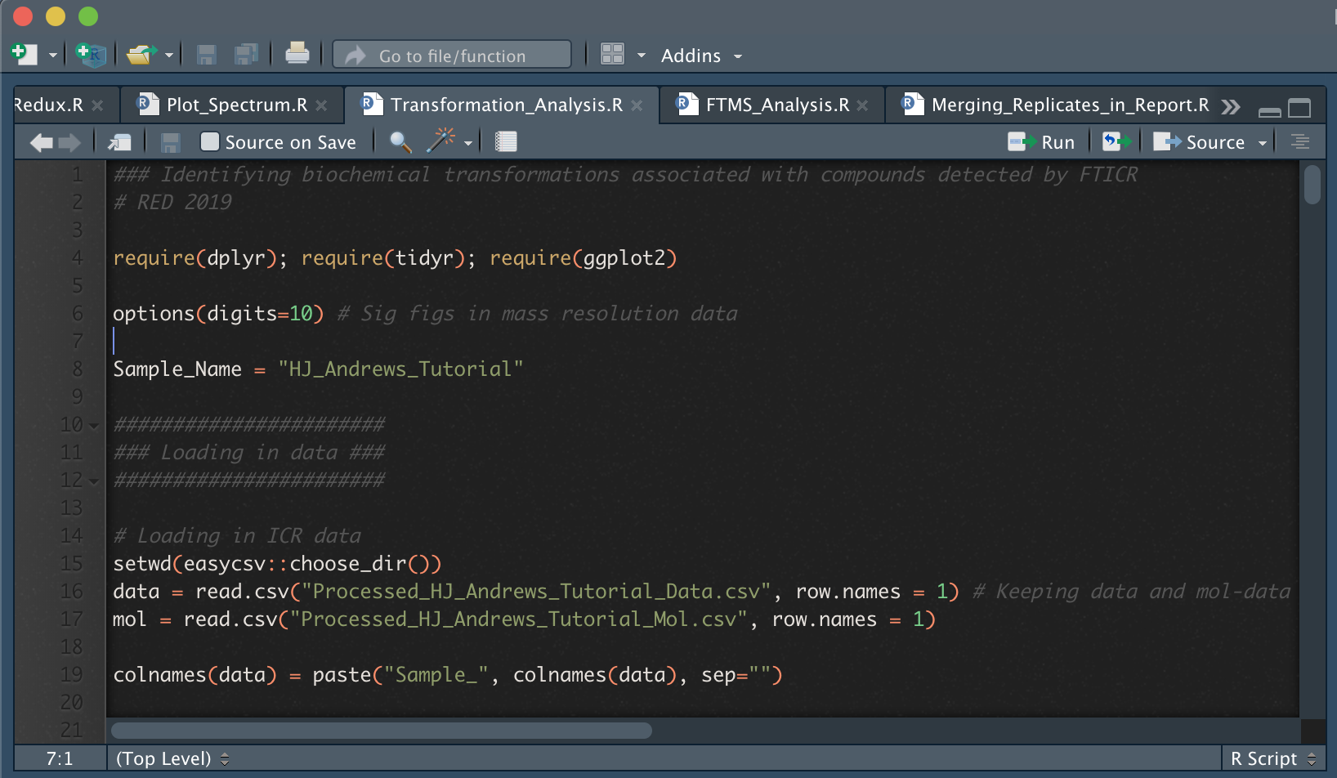
The transformation analysis
This is a quick view of the Transformation_Analysis.R script which will match mass differences to biochemical reactions
Pressing the “Source” button will run the entire script
You should see a pop-up asking you to select the directory containing the Data and Mol files
This script will generate a trans. profile, many pairwise trans. files, and two figures

Slide 33
Investigating carbon use efficiency
Using calculations from Hyun Seob Sung, we can measure carbon use efficiency
Using λ, we can derive the “stoichiometric coefficient” or Y_{Cs,i} – the number of moles required to generate biomass
Systems which require more are not optimized, while those which require more are efficient
By tracking carbon use efficiency through space/time, we can investigate factors affecting biogeochemical cycles
Thermodynamic representation of energy coupling
S(E_{d}, E_{a})
P
Catabolism
ΔG_{Cat}
Metabolic
reaction
ΔG_{Dis}
ΔG_{An}
Dissipation
(constant fraction)
Anabolism
Cs, Ns
Biom
λ is the number of times the catabolic reaction runs to produce one C-mole of biomass
Song et al., in prep

Slide 34
Investigating carbon use efficiency
This is a quick view of the the Carbon_Efficiency.R script which uses the calculations devised by Hyun Seob Song
Pressing the “Source” button will run the entire script
You should see a pop-up asking you to select the directory containing the Report
This script will generate a figure demonstrating carbon use efficiency through time

Slide 35
Data Interpretation
Comparisons of AA Transformations
With these results in hand, we can better understand our ecosystem
There are amino acid transformations which occur more frequently than others
Carbon use efficiency is slightly dynamic through time, but does not substantially vary between water types
While nothing conclusive can be drawn from these two data types alone, by expanding this study to other multivariate analyses we can develop conceptual models
Y_{Cs,i} through time

Slide 36
What do we plan to cover in this tutorial?
A brief introduction to FTICR-MS as a technique
How is data collected and what happens to it before it reaches you?
FREDA and ftmsRanalysis: Tools which help us analyze FTICR data
Allison Thompson will walk us through the process
Relating FTICR data to other ‘omics
I will guide you along data analysis performed by Emily Graham
Let’s process some data!
I’ve prepared an interactive walkthrough on how to visualize your data and generate conclusions
A brief glimpse into novel analyses that we are developing

Slide 37
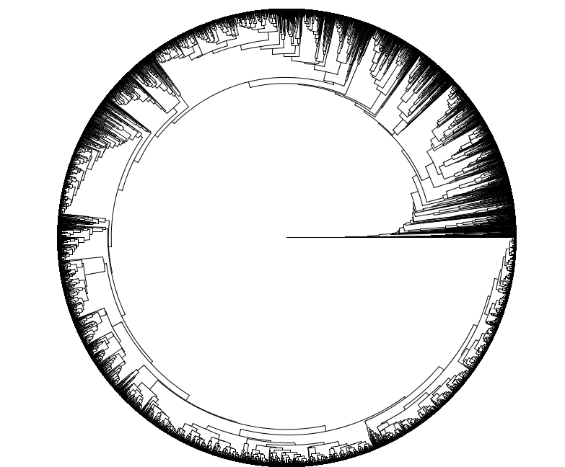
Multi-ecosystem Metabolomics
By investigating metabolite data through the lens of metacommunity ecology, we can reveal generalizable principles and enhance biogeochemical predictability
A key component of these analyses is the generation of a metabolite dendrogram
This allows us to estimate the “relatedness” between metabolites based upon transformations and molecular characteristics
Transformation-Weighted Characteristics Dendrogram
Danczak et al., in prep

Slide 38
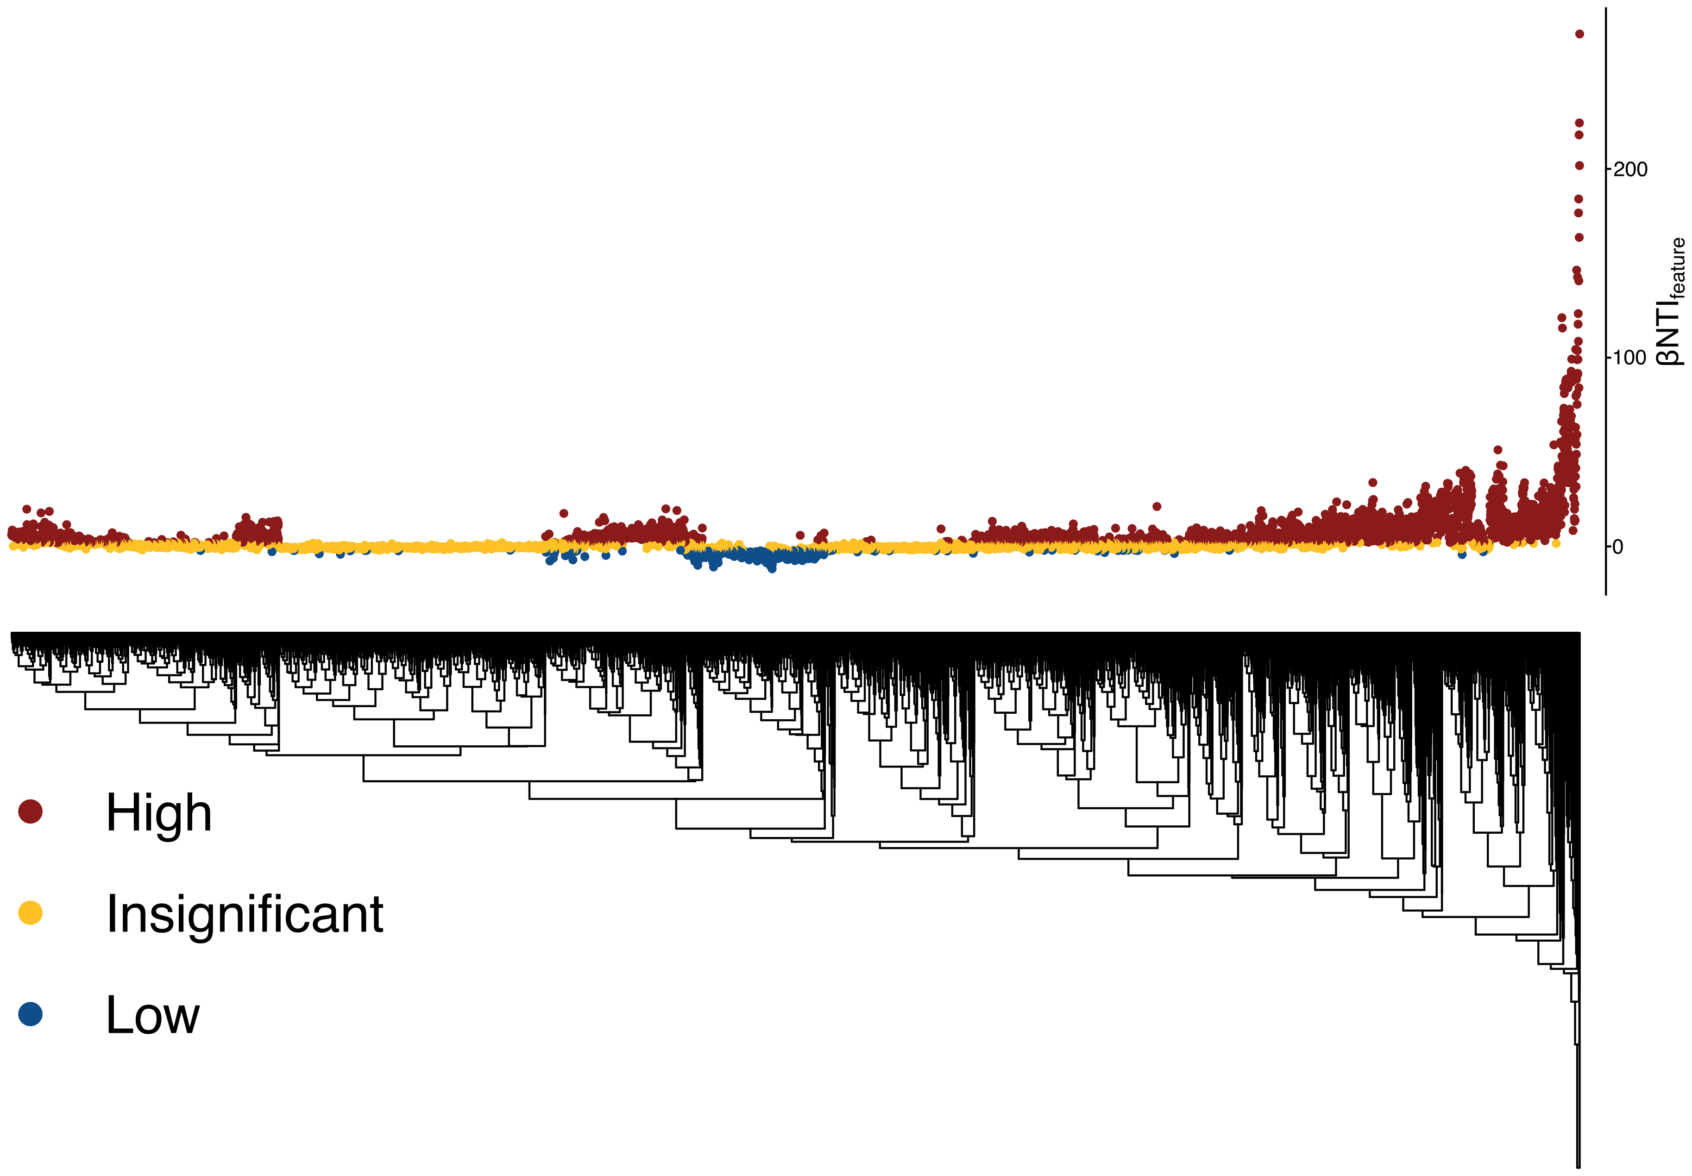
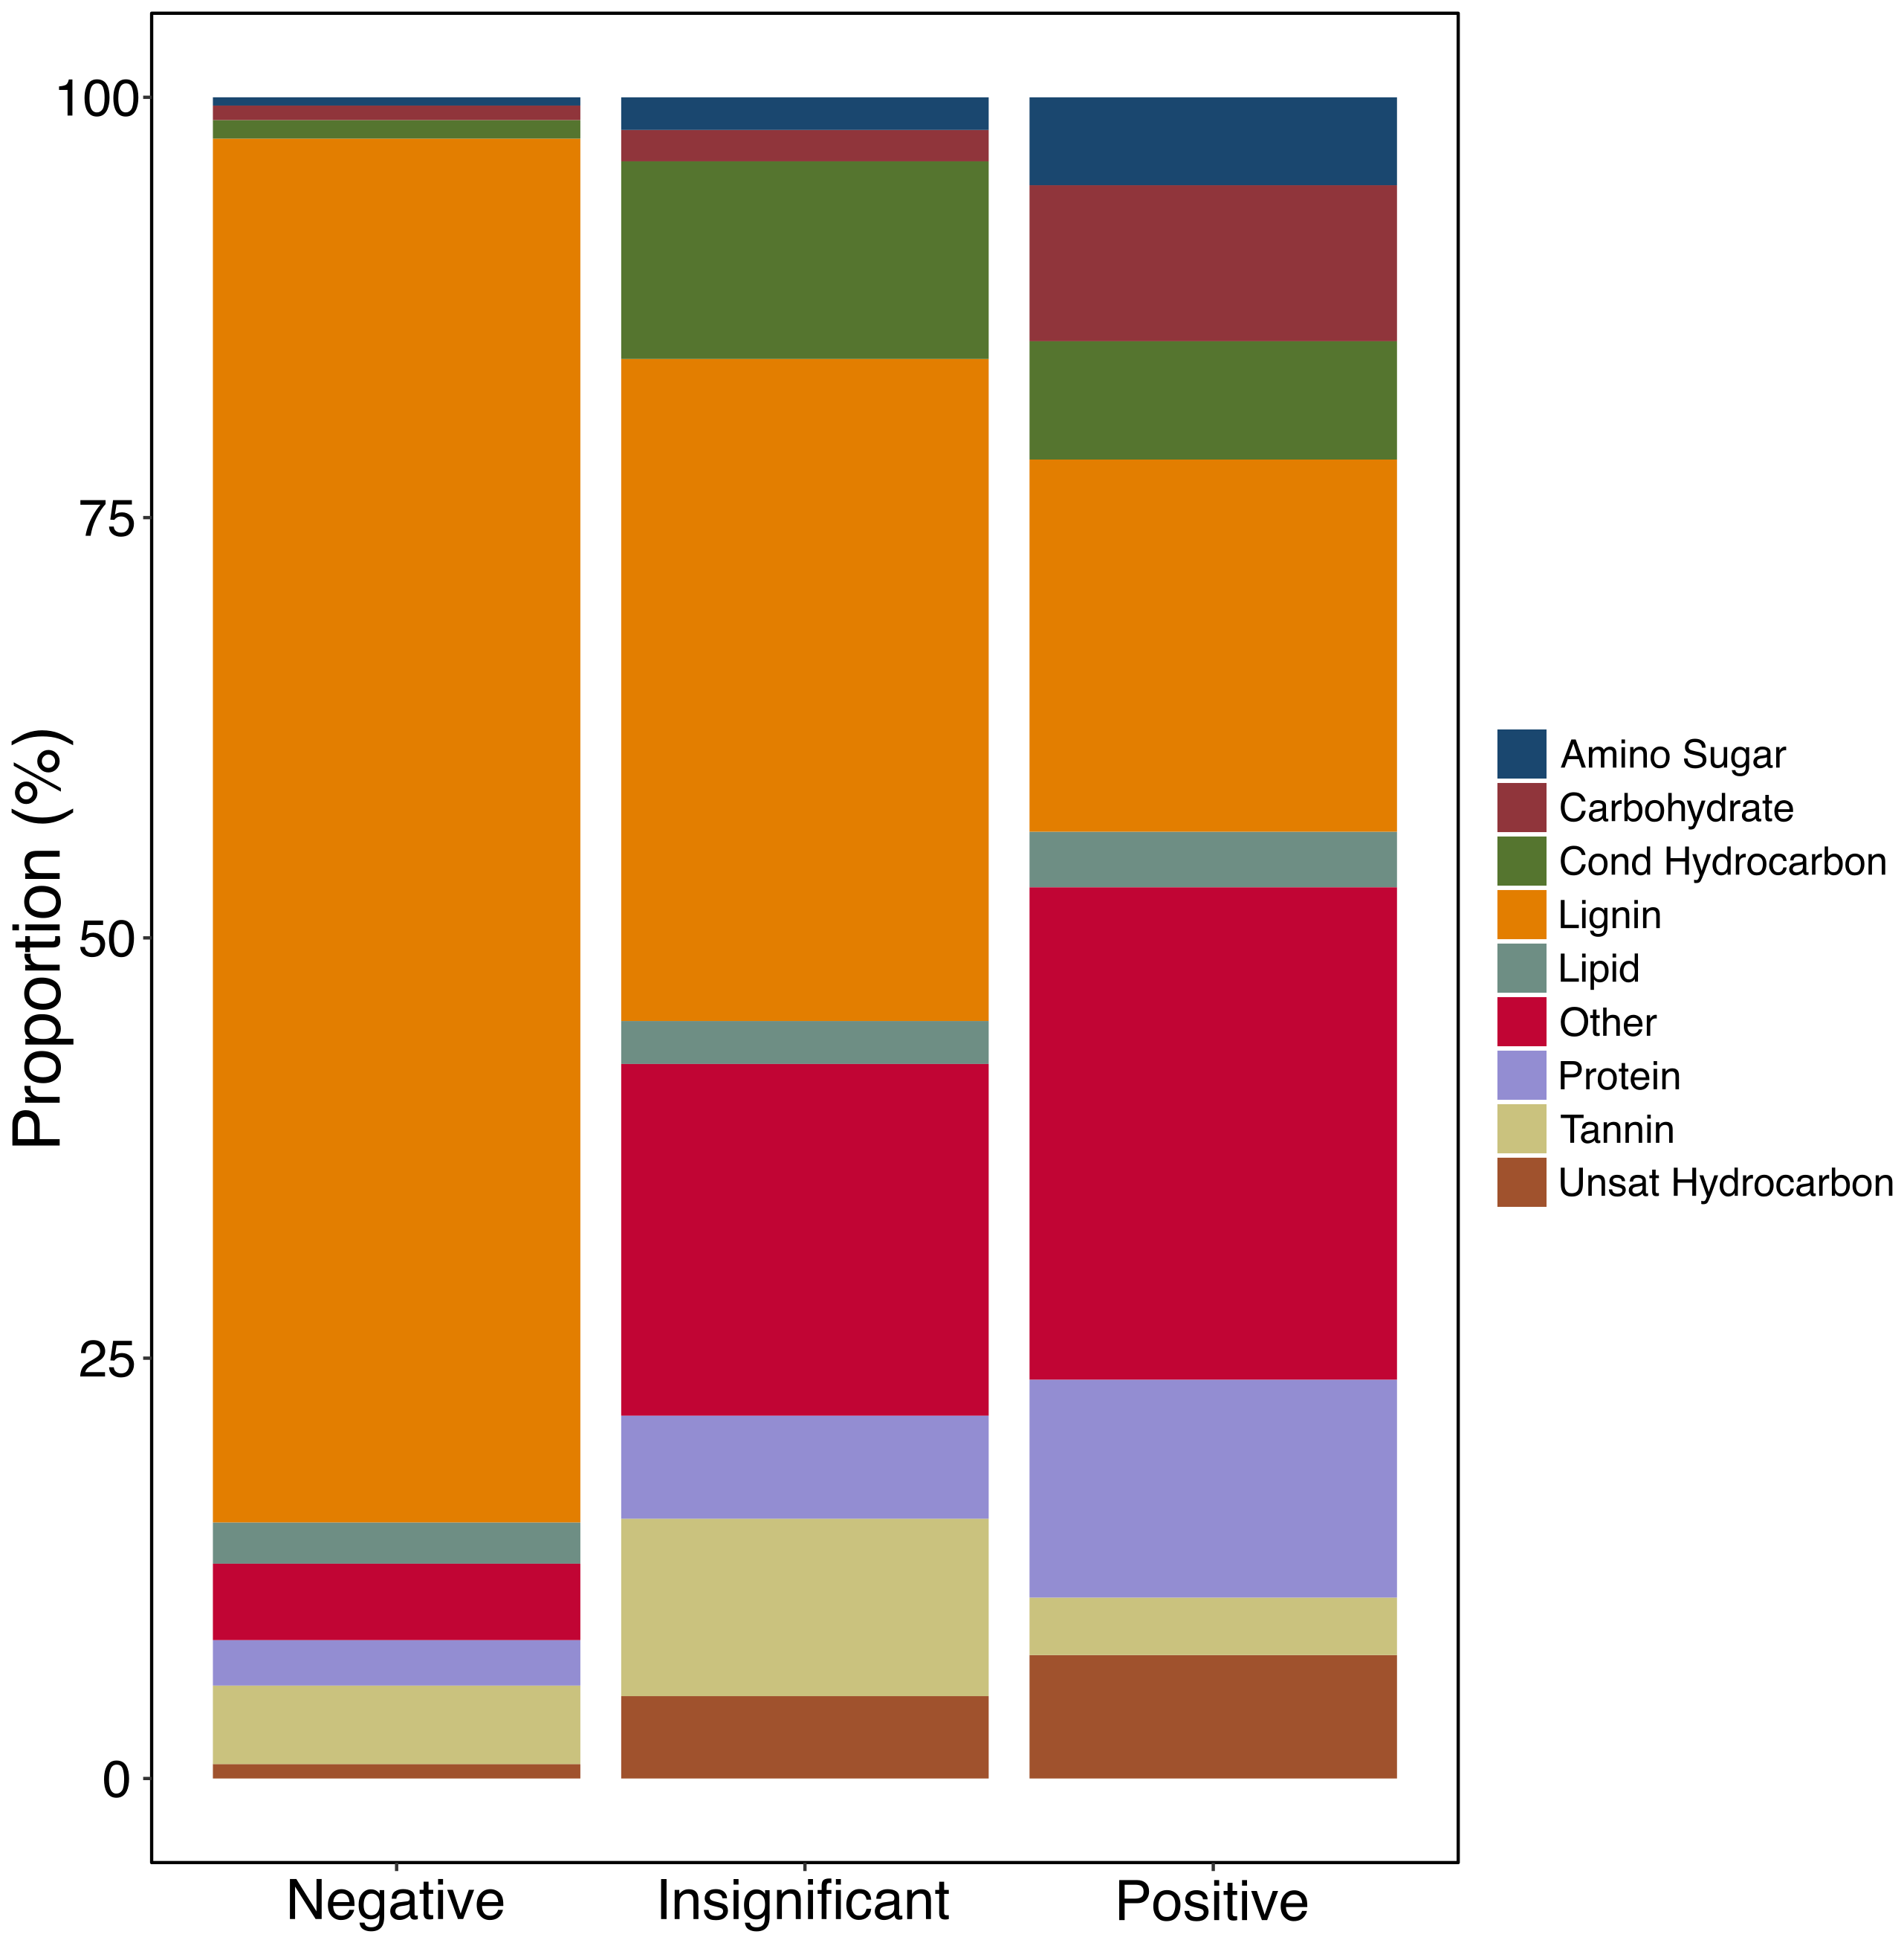
We can identify deterministically influential metabolites
Relational dendrograms allows the use of a broader suite of ecological tools
Many ecological metrics use relationships to improve diversity estimates
Initial results suggest these measurements help reveal generalizable principles
A new metric that we’ve developed (βNTI_{feature}) allows us to investigate features which overwhelmingly influence assemblage structure
Null modeling approach to determine which features are consistently more different or similar in a dataset
Can be used with microbial or metabolite data
Differences
Drives:
Similarities
Lignin-like
Carbohydrate-like
Others
Similarities
Differences
Danczak et al., in prep

Slide 39


Acknowledgements
James Stegen
Emily Graham
Allison Thompson, Lisa Bramer, and everyone who helped develop FREDA and ftmsRanalysis
Environmental Molecular Sciences Laboratory (EMSL)
Nikola Tolic
Rosey Chu
Jason Toyoda
Many others
The WHONDRS team
Amy Goldman
Vanessa Garayburu-Caruso
Lupita Renteria
Josh Torgeson
Jackie Wells (at OSU now)
Joseph Morad
Sawi Kumar
The SBR SFA
Everyone who sent in samples for WHONDRS

